Slide 1



SENTIMENT ANALYSIS OF RESTAURANT REVIEWS
Natural Language Processing and
Machine Learning for Text Sentiment Classification
Akshay Gurnani ,22
Deepak Rajani ,53
Piyush Batheja ,70

Slide 2
Problem Statement
The objective of this Natural Language Processing (NLP) project is to develop a system that can automatically predict restaurant ratings based on customer reviews. By analyzing the textual content of reviews using various NLP techniques, the system aims to accurately estimate the corresponding numerical rating (1-5 stars) that a customer would give. The project involves transforming textual data into features that can be used by machine learning models to predict ratings.

Slide 3
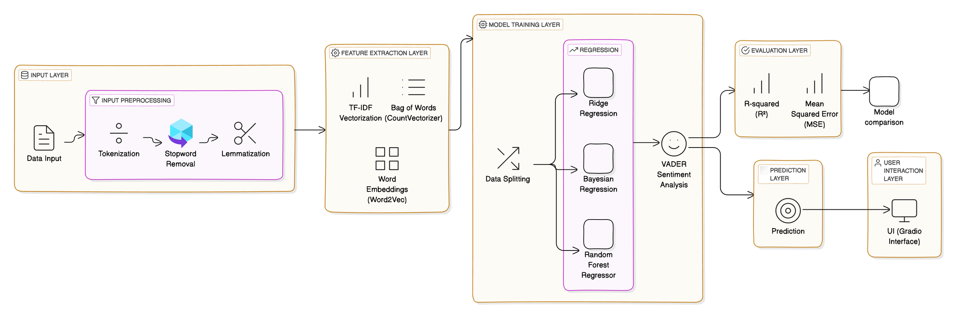
System Architecture

Slide 4
Algorithms
Models for Rating Prediction:
Random Forest Regressor: An ensemble learning method that combines multiple decision trees to improve prediction accuracy and control overfitting.
Ridge Regression: A type of linear regression that includes L2 regularization to prevent overfitting by penalizing large coefficients.
Bayesian Regression: A probabilistic model that incorporates prior beliefs about parameters and updates them based on observed data.
Sentiment Analysis Tools:
VADER (Valence Aware Dictionary and sEntiment Reasoner): A rule-based model designed for sentiment analysis in short texts. It assigns sentiment scores to words and combines them to evaluate overall sentiment.
Feature Extraction Methods:
Bag of Words (CountVectorizer): Represents text as a matrix of word counts, disregarding grammar and word order.
TF-IDF (Term Frequency-Inverse Document Frequency): Measures the importance of a word in a document relative to a corpus, reducing the weight of common words.
Word Embeddings (Word2Vec): Transforms words into numerical vectors that capture semantic relationships and context.

Slide 5
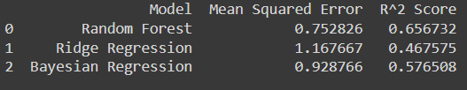
Output
Random Forest outperforms the others with the lowest Mean Squared Error (MSE) of 0.742006 and the highest R² score of 0.656 Interpretation of Results:
MSE: A low value for Random Forest indicates accurate predictions close to actual ratings. R² Score: An R² score of 0.656 suggests that 65.67% of the variance in ratings is explained by the model, indicating a good fit. Why Random Forest is Preferred:

Slide 6
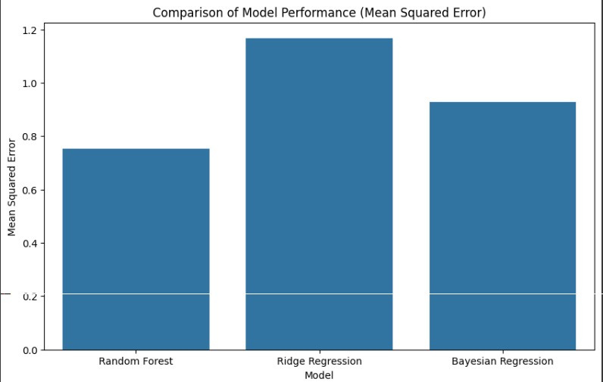

Slide 7
Conclusion
Sentiment analysis helps extract valuable insights from restaurant reviews.
Preprocessing and feature extraction are essential for converting text into usable data.
Models like Random Forest and Bayesian Linear Regression predict ratings with good accuracy.
Evaluated using MSE and R², these models help automate review analysis

